Slide 1
Maintainability Design III Development Strategy
CS 301: IT Solution Architecture
Week 6

Slide 2
Objective
Key learning objectives
Understand the importance of a development strategy
Able to draw activity diagram to illustrate your development strategy
Implement Infrastructure as Code for AWS using CloudFormation

Slide 3
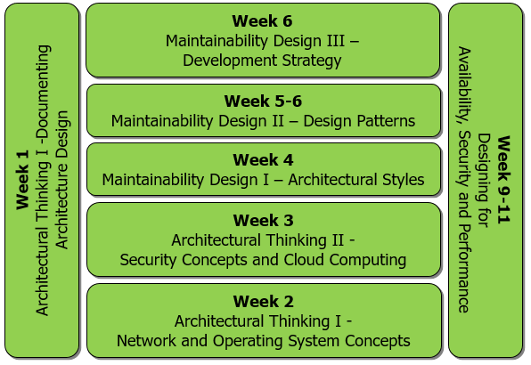
Maintainability Considerations
Software Coding
Coding Guidelines
Software Design and Development
Object-oriented Design
Design Principles and Patterns
Development Strategy
Solution Architecture
Integration Patterns
Architecture Styles

Slide 4
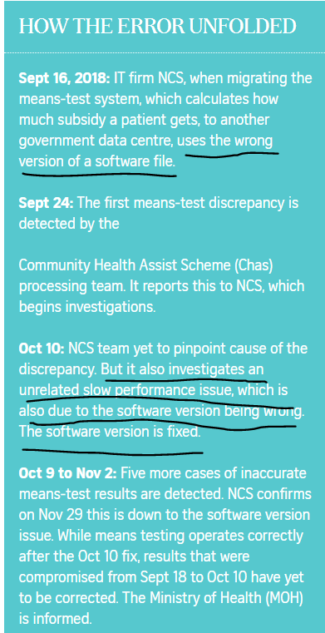
Problems that happen recently….

Slide 5

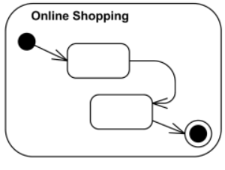
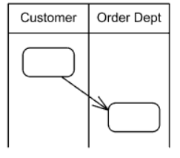
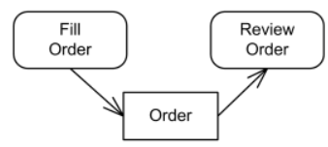
Activity Diagram
Activity
parameterized behavior represented as coordinated flow of actions.
Activity Edge
directed connections along which tokens or data objects flow between activity nodes.
Activity Partition
activity group for actions that have some common characteristic.
Object Flow
activity edges used to show data flow of object and data tokens between action nodes.
https://www.uml-diagrams.org/activity-diagrams.html

Slide 6
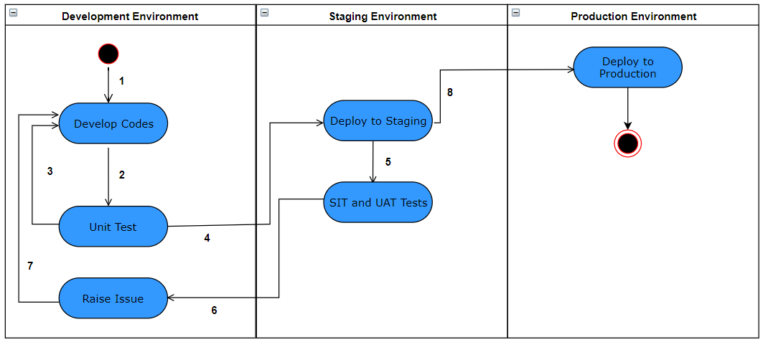
Development Process based on Activity Diagram
Developers implement the features (source codes, scripts) on their local workstations.
Developers write local test cases and test the features manually on their local workstations.
Developers fix the bugs and issues on their local workstations.
Developers deploy their features to staging by the deadline (e.g. 8 days before release). Lead developer manually compiles, integrates the features and configures the staging environment
Quality assurance staff write SIT/UAT test cases and test the codes manually on the staging.
Lead developer reviews issues. Issues cannot be fixed by release date are postponed to next cycle.
Lead developer assign actions to each developer.
Lead developer manually compile source codes from staging, deploy to production and configure the production server for final release by the deadline (e.g. 2 days before release)
Discuss the possible issues and how to mitigate these issues
Notes:
Discuss the possible issues and how to mitigate these issues
Development and testing on local machines
Manual integration and configurations of staging and production environment
Manual testing by Quality assurance.
Some good points
Quality assurance writes the SIT/UAT test cases not the developers
Some form of issue management is being implemented
Activity diagram should also include the object flow.

Slide 7
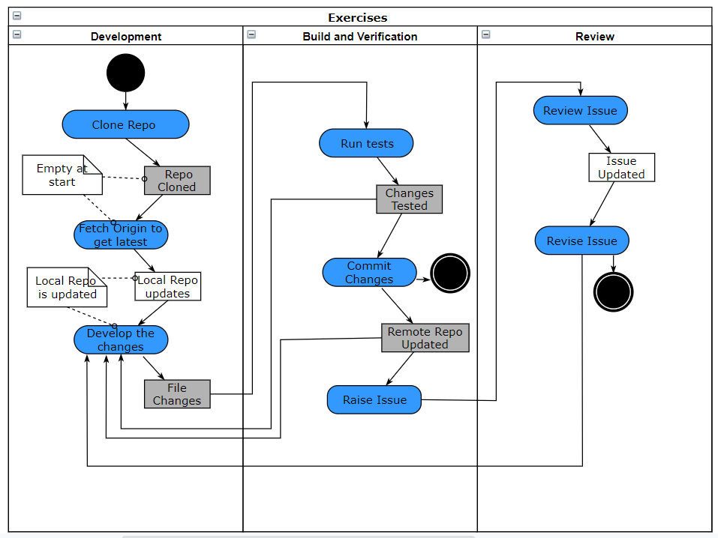
Another example based on class exercises

Slide 8















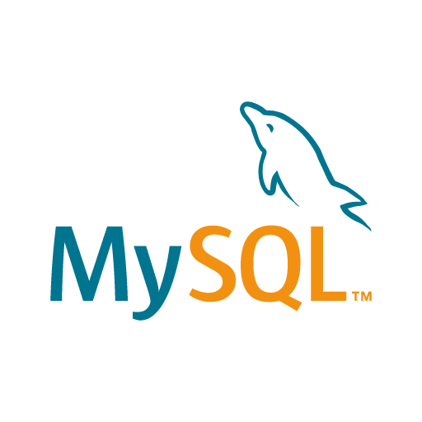


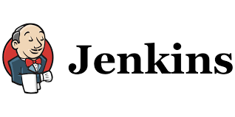
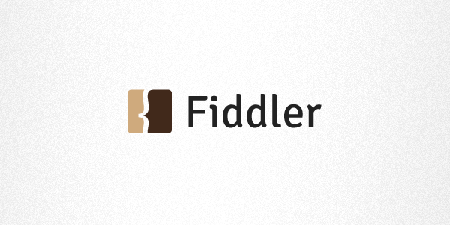

Tools Example
Development
Build and Verification
Integration and Test
Deploy
Others
Others
Others
Others
These tools can be used for your project implementation too. However, detailed configurations of these tools are not required in examination.

Slide 9
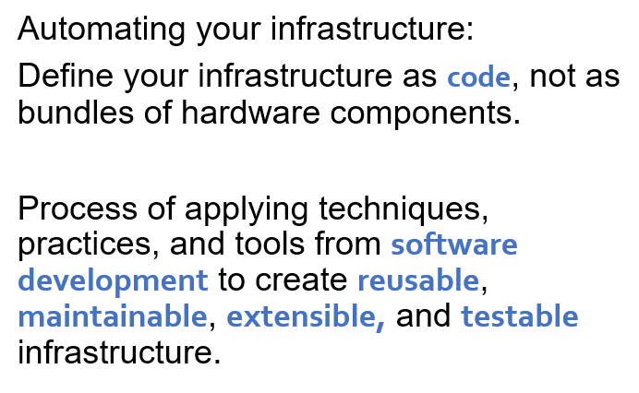
Infrastructure as Code
Notes:
When we talk about infrastructure as code, what do we mean?
There are many components to automating your infrastructure, but the most critical one is defining your infrastructure as code, not as bundles of hardware components. Thinking of infrastructure as code is the process of applying techniques, practices, and tools from software development to create reusable, maintainable, extensible, and testable infrastructure.

Slide 10
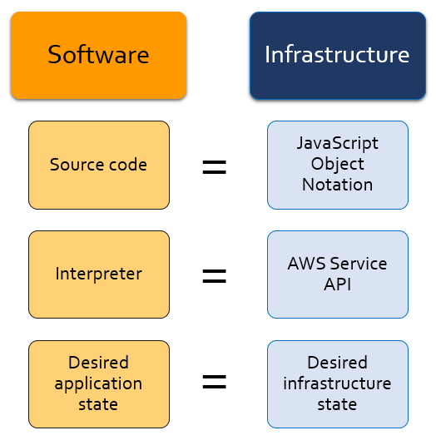
Build your Infrastructure like Software
Notes:
Code is extensible, changeable, and reusable.
Let’s compare software to infrastructure. Software has source code, and infrastructure has an equivalent in JavaScript Object Notation, or JSON. Software has an interpreter, and infrastructure has an equivalent in AWS service application programming interfaces, or APIs. Software has a desired application state, and infrastructure has a desired infrastructure state.
Repeatability is a big advantage when you treat infrastructure as code. For example, you can take an AWS CloudFormation template and roll out the development environment. You can test automatic scaling and the applications. When the test is successful, that exact template can be reused to launch resources that have been thoroughly tested in the development environment into production.
If you build infrastructure with code, you gain the benefits of repeatability and reusability while you build your environments. With one template or a combination of templates, you can build the same complex environments over and over again. When you do this with AWS, you can even create environments that depend on conditions, so that what you build is specific to the context where you created it. For instance, a template can be designed so that different Amazon Machine Images (AMIs) are used, based on whether this template was launched into the development environment or the production environment.

Slide 11
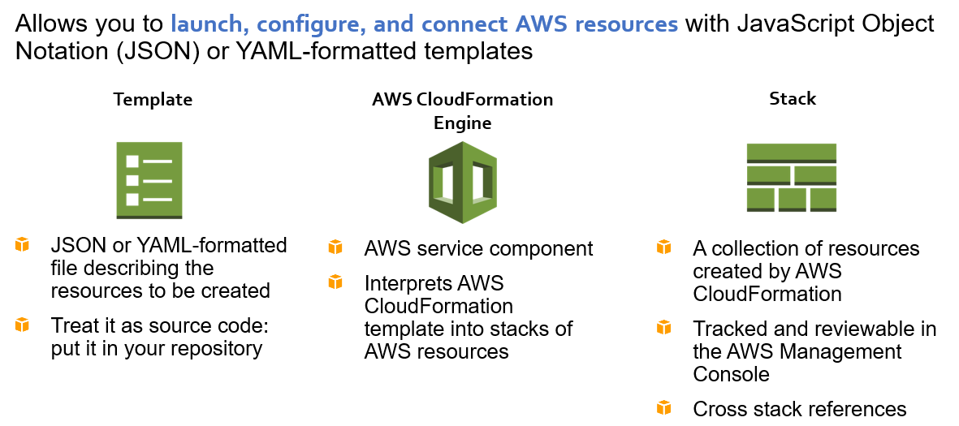
AWS CloudFormation
Notes:
With AWS CloudFormation, you can treat infrastructure as code. AWS CloudFormation allows you to create templates that can be used to launch, configure, and connect AWS resources with JavaScript Object Notation (JSON) or YAML-formatted templates.
An AWS CloudFormation template allows you to:
•Treat it as code, and manage it by using your choice of version control, such as Git or Subversion.
•Define an entire application stack—which is all the resources required for your application—in a JSON template file.
•Define runtime parameters for a template, such as Amazon Elastic Compute Cloud—or Amazon EC2—Instance Size, Amazon EC2 Key Pair, etc.
You can now create YAML-formatted templates to describe your AWS resources and properties in AWS CloudFormation. You can use either YAML-formatted templates or JSON-formatted templates to model and describe the resources and properties in your AWS infrastructure. Both YAML-formatted and JSON-formatted AWS CloudFormation templates have the same structure, and they both support all the same features. You can now also create cross stack references that let you share outputs from one stack with another stack. This feature lets you share things like AWS Identity and Access Management—or IAM—roles, virtual private cloud—or VPC—information, and security groups. Previously, you needed to use AWS CloudFormation custom resources to accomplish these tasks. Now, you can export values from one stack and import them to another stack by using the new ImportValue intrinsic function.
Cross-stack references are useful for customers who separate their AWS infrastructure into logical components that grouped by stack—such as a network stack, an application stack, etc.—and who need a way to loosely couple stacks together as an alternative to nested stacks.

Slide 12
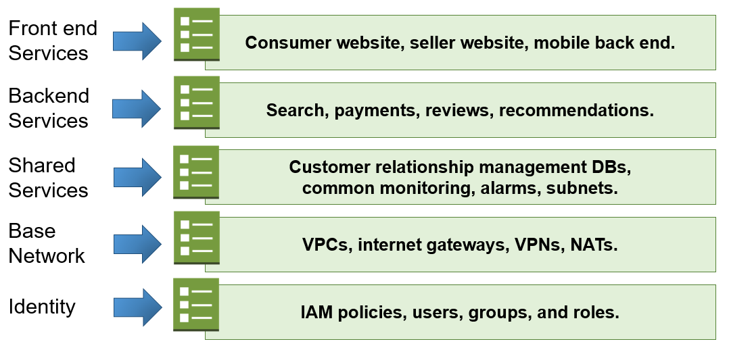
AWS CloudFormation - Grouping
Notes:
While templates can be reused to create multiple environments or parts of environments, we do not recommend building all of an application's within one template .
Resources should be grouped into templates based on their ownership and their place in the application lifecycle. At a minimum, you should separate network resources, security resources, and application resources into their own templates. With security resources, you might want to lock them down by separating them from the rest of your templates.
For example, a network resource template named “NetworkSharedTierVpcIgwNat.template” might include definitions for the following
resources: VPCs, subnets, internet gateways, route tables, and network access control lists, or ACLs.
Also, a test environment and a production environment should probably not share the same templates in most cases. Resources in a test environment will need to change frequently, while resources in a production environment should be relatively stable. In addition, we do not recommend sharing templates across management teams because different needs and standards can impact teams inappropriately
Avoid sharing a single template across applications for resources of the same type unless you are deliberately centralizing control of that resource type.
You don’t want to have too many things inside of one template across numerous applications. If you have an application template that supports only one application, changes to the template only affect that one application. If you have an application template that supports several applications, changes to the template will affect several applications, and the changes can cause all of the applications to be retested. For this reason, we do not recommend using a single template across multiple applications.
Consider storing templates that contain security resources in a separate repository from other templates.
Here's an example of how stack can be grouped with AWS CloudFormation groups. You could have front-end services like a consumer website, a seller website, or a mobile backend. There might be backend services for search, payments, reviews or recommendations. Shared services could include customer relationship management databases, common monitoring, alarms, and subnets. The base network could include VPCs, internet gateways, virtual private networks or VPNs, and network address translation or NAT. Finally, identity could include IAM policies, users, groups, and roles.
When you think about how to bundle resources into your AWS CloudFormation templates, a good guideline is to organize the resources like they are software. Think about the tightly connected components to your infrastructure, and put them in the same templates. In this example, AWS CloudFormation resources are grouped into five different templates: front-end services, backend services, shared services, base network services, and identity resources.

Slide 13
AWS CloudFormation template structure
"Description" : "JSON string",
"Metadata" : {
template metadata },
"Parameters" : {
set of parameters },
"Mappings" : {
set of mappings },
"Conditions" : {
set of conditions },
"Resources" : {
set of resources },
"Outputs" : {
set of outputs }
Description:
Text string that describes the template.
Literal string between 0 and 1024 bytes long
Cannot use a parameter or function to specify it
"Description" : "This template builds a VPC with one public and one private subnet",
JSON example
Notes:
https://docs.aws.amazon.com/AWSCloudFormation/latest/UserGuide/template-anatomy.html
This slide shows the anatomy of an AWS CloudFormation template. The top has a description, which is a text string that describes the template.
For more information, go to the AWS CloudFormation documentation about the template Description section.
http://docs.aws.amazon.com/AWSCloudFormation/latest/UserGuide/template-description-structure.html

Slide 14
Metadata
"Description" : "JSON string",
"Metadata" : {
template metadata },
"Parameters" : {
set of parameters },
"Mappings" : {
set of mappings },
"Conditions" : {
set of conditions },
"Resources" : {
set of resources },
"Outputs" : {
set of outputs }
Metadata:
JSON objects that provide additional details about the template.
Includes settings or configuration information that some AWS CloudFormation features need to retrieve
Can be specified at the template or resource level
"Metadata" : {
"Instances" : {"Description" : "<Information about the instances>"},
"Databases" : {"Description" : "<Information about the databases>"}}
JSON example
Notes:
Next, the template includes metadata, which can be described as data about the data. In a JSON template, JSON objects can be used to provide additional details about the template.
Some AWS CloudFormation features retrieve settings or configuration information that you define from the Metadata section. You define this information in the following AWS CloudFormation-specific metadata keys:
AWS::CloudFormation::Init
Defines configuration tasks for the cfn-init helper script. This script is useful for configuring and installing applications on Amazon EC2 instances. For more information, see AWS::CloudFormation::Init.
AWS::CloudFormation::Interface
Defines the grouping and ordering of input parameters when they are displayed in the AWS CloudFormation console. By default, the AWS CloudFormation console alphabetically sorts parameters by their logical ID. For more information, see AWS::CloudFormation::Interface.
AWS::CloudFormation::Designer
Describes how your resources are laid out in AWS CloudFormation Designer. Designer automatically adds this information when you use it create and update templates. For more information, go to the documentation page that explain AWS CloudFormation Designer: https://docs.aws.amazon.com/AWSCloudFormation/latest/UserGuide/working-with-templates-cfn-designer.html
To learn more about template metadata, go to the AWS CloudFormation documentation about the Metadata section. http://docs.aws.amazon.com/AWSCloudFormation/latest/UserGuide/metadata-section-structure.html

Slide 15
Parameters
"Description" : "JSON string",
"Metadata" : {
template metadata },
"Parameters" : {
set of parameters },
"Mappings" : {
set of mappings },
"Conditions" : {
set of conditions },
"Resources" : {
set of resources },
"Outputs" : {
set of outputs }
Parameters:
Values you can pass in to your template at runtime.
Allow stacks to be customized at launch of a template
Can specify allowed and default values for each parameter
JSON example
Notes:
In this example, a parameter allows you to pass the value of your template at runtime, which allows you to customize things in the stack. You can specify allowed and default values for each parameter.
You declare parameters in a template's Parameters object. A parameter contains a list of attributes that define its value, and also define constraints against its value. The only required attribute is Type, which can be String, Number, or CommaDelimitedList. You can also add a Description attribute that tells a user more about what kind of value they should specify. The parameter's name and description appear in the Specify Parameters page when a user uses the template in the Create Stack wizard.
For more information, go to the AWS CloudFormation documentation about creating and using parameters. https://docs.aws.amazon.com/AWSCloudFormation/latest/UserGuide/parameters-section-structure.html

Slide 16
Resources
Resources:
Resources (and their properties) that will be included in the stack.
Properties:
Each resource must be declared separately (except multiple instances of the same resource)
Resource declaration has the resource’s attributes
"Description" : "JSON string",
"Metadata" : {
template metadata },
"Parameters" : {
set of parameters },
"Mappings" : {
set of mappings },
"Conditions" : {
set of conditions },
"Resources" : {
set of resources },
"Outputs" : {
set of outputs }
"Resources" : {
"Logical ID" : {
"Type" : "Resource type",
"Properties" : {
Set of properties } } }
JSON example
Notes:
The Resources section is required, and it declares the AWS resources that will be included or created in the stack, such as an Amazon EC2 instance or an Amazon Simple Storage Service –or Amazon S3—bucket. You must declare each resource separately; however, you can specify multiple resources of the same type. If you declare multiple resources, separate them with commas.
For more information, go to the AWS CloudFormation documentation on how to create and use resources. http://docs.aws.amazon.com/AWSCloudFormation/latest/UserGuide/resources-section-structure.html

Slide 17
Parameters and Resources Examples
"Parameters" : {
"InstanceTypeParameter" : {
"Type" : "String",
"Default" : "t2.micro",
"AllowedValues" : ["t2.micro", "m1.small", "m1.large"],
"Description" : "Enter t2.micro, m1.small, or m1.large. Default is t2.micro." } }
"Resources" : {
“Ec2Instance" : {
"Type" : "AWS::EC2::Instance",
"Properties" : {
"InstanceType" : { "Ref" : "InstanceTypeParameter" },
"ImageId" : "ami-2f726546"
}
}
JSON example
Notes:
In this example, the InstanceTypeParameter specifies a default Amazon EC2 instance type of t2.micro, but users can choose from a t2.micro, m1.small, or m1.large instance type when they invoke the template. It also provides a description, which appears in the AWS CloudFormation Console when the template is launched.
Then, when an Amazon EC2 instance is launched in the Resources section of the template, the Properties section of the instance can reference the InstanceTypeParameter specification. In this example, the “Ec2Instance" resource—which is an Amazon EC2 instance—references the InstanceTypeParameter specification for its instance type. You could also specify details like the range of acceptable AMI ImageId numbers, key pairs, subnets, or any properties that must be specified for a resource.

Slide 18
Resource: DependsOn
The "DependsOn" attribute specifies that the creation of a specific resource follows another. You can use the DependsOn attribute with any resource.
"Resources" : {
“AppServerInstance" : {
"Type" : "AWS::EC2::Instance",
"Properties" : {
"ImageId" : {
"Fn::FindInMap" : [ "RegionMap", { "Ref" : "AWS::Region" }, "AMI" ]
}
},
"DependsOn" : "myDB"
},
"myDB" : {
"Type" : "AWS::RDS::DBInstance",
"Properties" : {
…
}
Creates the Amazon EC2 instance only after the RDS database instance has been created.
JSON example
Notes:
The DependsOn attribute is an important attribute. DependsOn is how you specify that AWS CloudFormation should wait to launch a resource until a specific, different resource has already finished being created.
In this case, there is an Amazon EC2 instance that can only be created after the database has been established. So, the creation of the Amazon EC2 instance depends on when the database is created.

Slide 19
Mappings
"Description" : "JSON string",
"Metadata" : {
template metadata },
"Parameters" : {
set of parameters },
"Mappings" : {
set of mappings },
"Conditions" : {
set of conditions },
"Resources" : {
set of resources },
"Outputs" : {
set of outputs }
Mappings:
Keys and associated values that specify conditional parameter values.
"Mappings" : {
"RegionMap" : {
"us-east-1" : { "64" : "ami-6411e20d"},
"eu-west-1" : { "64" : "ami-37c2f643"},
"ap-southeast-1" : { "64" : "ami-66f28c34"},
}
}
JSON example
Notes:
Mappings are keys and their associated values, and they specify conditional parameter values. Mappings allow you to customize the properties of a resource based on certain conditions, which enables you to have fine-grained control over how your templates are launched. For example, an AMI ImageId number is unique to a Region, and the person who received your template might not necessarily know which AMI to use. You can thus provide the AMI lookup list using the Mappings parameter.
This example contains a map for Regions. The mapping lists the AMI that should be used, based on the Region that the EC2 instance will launch in.
For more information, go to the AWS CloudFormation documentation on how to create and use Mappings.
https://docs.aws.amazon.com/AWSCloudFormation/latest/UserGuide/mappings-section-structure.html

Slide 20
Conditions
"Description" : "JSON string",
"Metadata" : {
template metadata },
"Parameters" : {
set of parameters },
"Mappings" : {
set of mappings },
"Conditions" : {
set of conditions },
"Resources" : {
set of resources },
"Outputs" : {
set of outputs }
Conditions:
Control whether certain resources are created or certain properties are assigned a value during stack creation or update.
JSON example
Notes:
The optional Conditions section includes statements that control whether certain resources are created, or whether certain properties are assigned a value during the creation or update of a stack. For example, you can compare whether a value is equal to another value. Based on the result of that condition, you can conditionally create resources. If you have multiple conditions, separate them with commas.
You might use conditions when you want to reuse a template that can create resources in different contexts, such as a test environment versus a production environment. In your template, you can add an EnvironmentType input parameter, which accepts either “prod” or “test” as inputs. For the production environment, you might include Amazon EC2 instances with certain capabilities; however, for the test environment, you want to use reduced capabilities to save money. With conditions, you can define which resources are created, and how they're configured for each environment type.
Conditions are evaluated based on input parameter values that you specify when you create or update a stack. Within each condition, you can reference another condition, a parameter value, or a mapping. After you define all your conditions, you can associate them with resources and resource properties in the Resources and Outputs sections of a template.
For more information, see the AWS CloudFormation documentation on how to create and use conditions.
http://docs.aws.amazon.com/AWSCloudFormation/latest/UserGuide/conditions-section-structure.html

Slide 21
Conditions Example
"Parameters" : {
"EnvType" : {
"Description" : "Specifies if this is a Dev, QA or Prod env",
"Type" : "String",
"Default" : "Dev",
"AllowedValues" : ["Dev", "QA", "Prod"]
}
},
"Conditions" : {
“CreateProdResources" : {"Fn::Equals" : [{"Ref" : "EnvType"},
“Prod"]}
},
…
JSON example
CreateProdResources condition evaluates to true if EnvType is Prod
Notes:
This is an important one to pay attention to because if values or tags have been assigned, the template will do something different based on the assigned value.
In this example, the EnvType parameter specifies whether you want to create a Dev environment, a QA—environment, or a Prod environment. Depending on the environment, you might want to specify different configurations, such as which database it points to. You can use “Condition” to evaluate this, and specify appropriate resources for each environment.

Slide 22
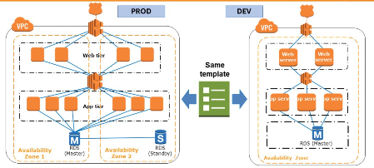
Building Environments using Conditions
Notes:
When the previous template is applied to this example, only one set of resources in one Availability Zone is launched when the target environment is development, or DEV. When this template is used in production--or PROD—the solution launches two sets of resources in two different Availability Zones. So, without making a single change, you can get a redundant environment from the same template.
Your production environment and development environment must have the same stack in order to ensure that your application works the way that it was designed. Your DEV environment and QA environment must have the same stack of applications and the same configuration. You might have several QA environments for functional testing, user acceptance testing, load testing, and so on. The process of creating those environments manually can be error-prone. You can use a Conditions statement in the template to solve this problem.

Slide 23
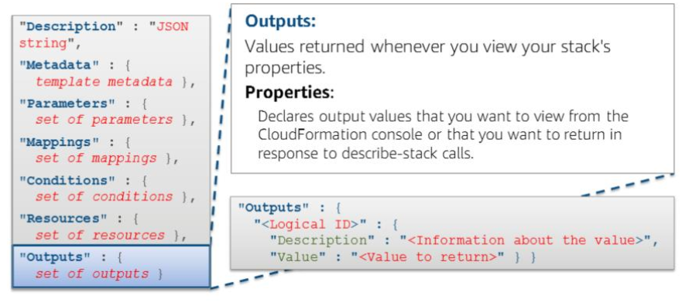
Output Example
Notes:
With an AWS CloudFormation template, you can specify an output. Outputs are values that are returned whenever you view the properties of your stack. For example, if something executes properly, it is helpful to provide an indication that the execution completed and was successful.
Outputs can specify the string output of any logical identifier that is available in the template. It's a convenient way to capture important information about your resources or input parameters.
For more information, go to the AWS CloudFormation documentation on how to create and use outputs.
http://docs.aws.amazon.com/AWSCloudFormation/latest/UserGuide/outputs-section-structure.html

Slide 24
Exercise
CloudFormation

